Slide 1














Snake Game
AI Using Deep Q-Learning

Slide 2

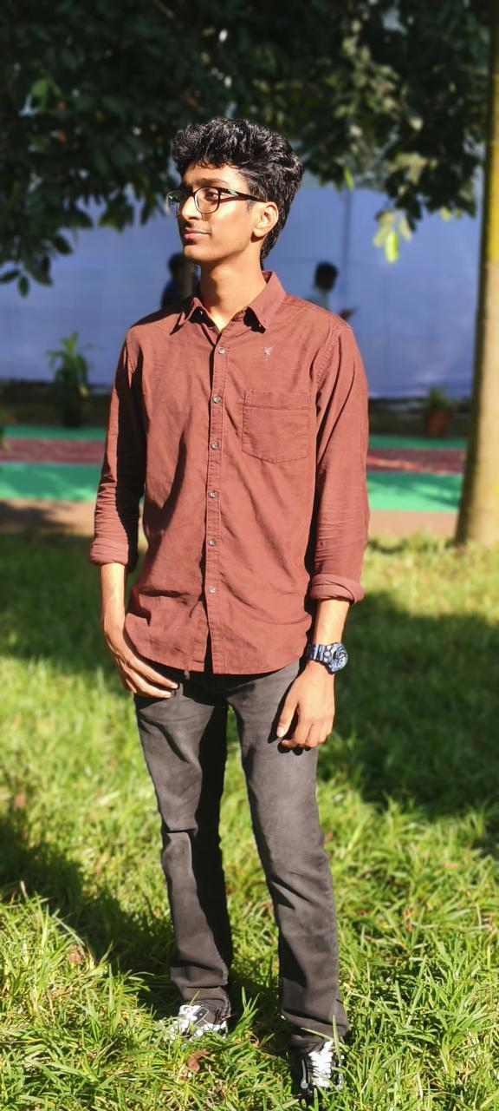

Team Members
Varun Yadav D
Sai Abhishek

Slide 3
We built the Snake Game from scratch using Python and Pygame. The snake, apple, background, and game interface were fully customized. We made sure the gameplay was smooth, the visuals were clean, and the sounds made it feel more interactive.
01.
Introduction
We used a method called Deep Q-Learning to train an AI agent. The agent learns by playing the game repeatedly and getting rewards for good moves (like eating the apple) and penalties for bad ones (like hitting walls). Over time, the model improves its decisions.
Project is about building a fun and interactive Snake Game and then making an AI agent smart enough to play the game on its own. The goal was to make the AI learn from experience just like humans do while playing.
02.
After training, the agent plays the game automatically without human help. It makes decisions based on what it learned during training. The trained agent can move toward the apple, avoid its own body, and survive for longer.
03.

Slide 4
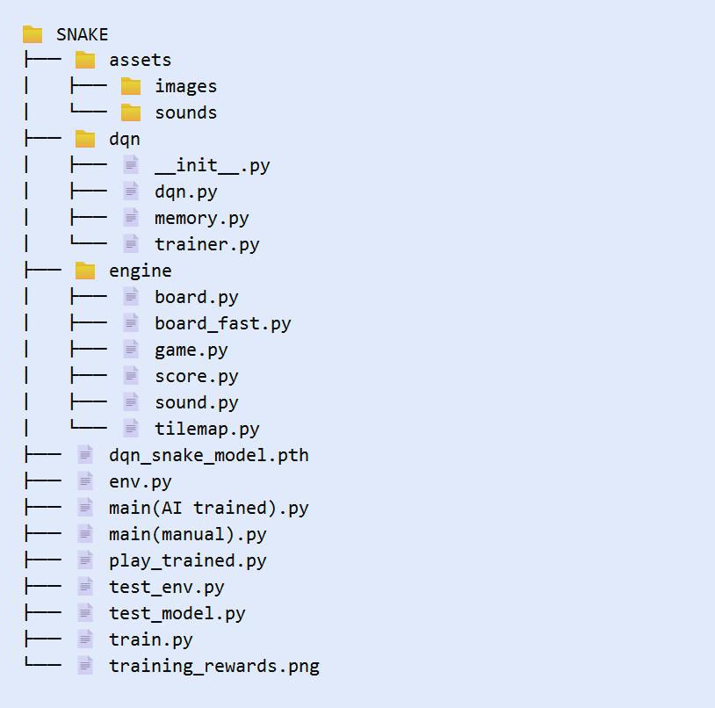
Project Folder Overview

Slide 5
Creation Process
Game Setup:
We used Python and Pygame to build a smooth-running and visually appealing snake game.
Manual Gameplay:
Initially, the game was built for manual play, where the player controls the snake using arrow keys to eat apples and avoid hitting walls or itself.
Game Components:
Visuals: Customized high-quality graphics for snake, apple, and background.
Sound Effects: Added realistic sounds like hiss, apple-eating, and collision effects to enhance gameplay experience.
User-Friendly Interface:
We ensured the game was simple and enjoyable for manual play, providing a solid foundation before introducing AI training.

Slide 6
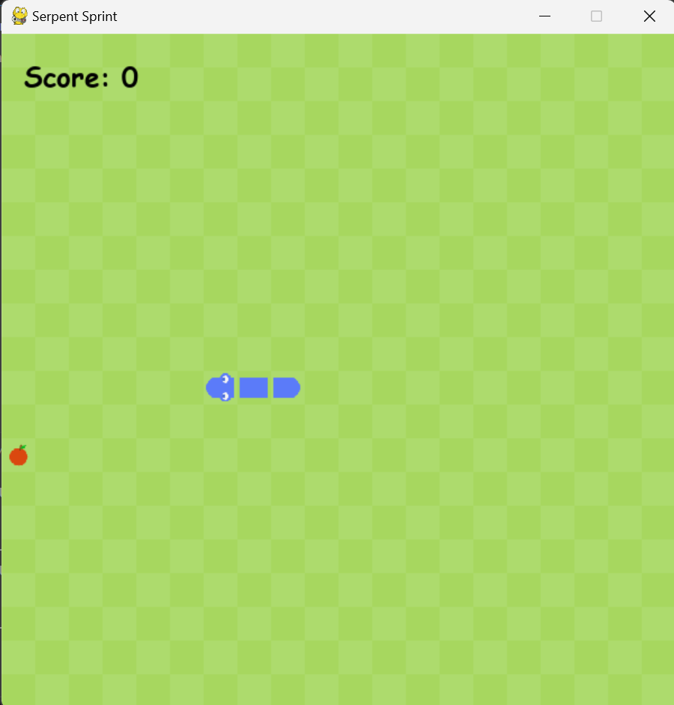
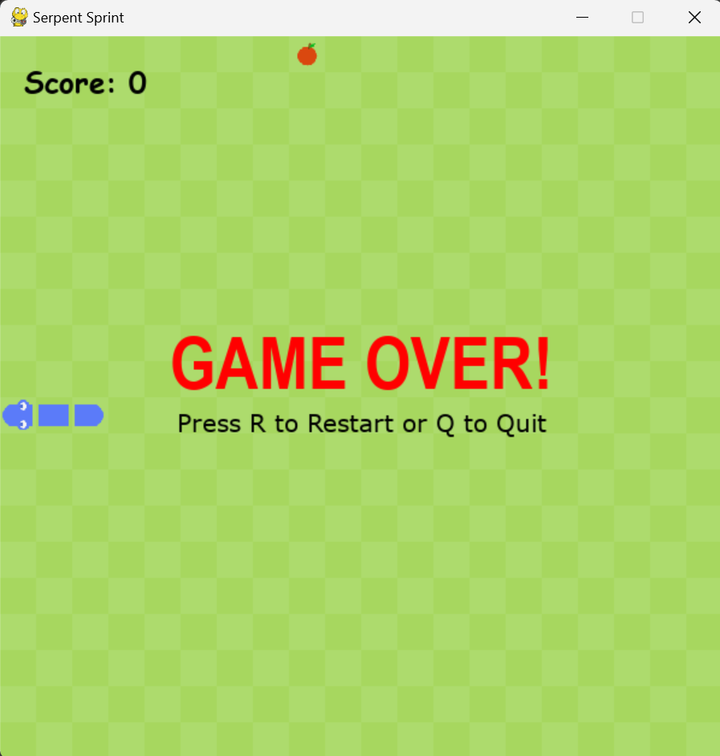

Slide 7
DQN (Deep Q-Network) helps our snake learn to make good moves by itself without being told exactly what to do.
The agent (the snake) needs to make decisions based on the current state and future outcomes.
dqn.py:
This file contains the neural network (DQN model).
It takes the current state (like snake position, apple position) and predicts the best move (up, down, left, or right).
memory.py:
This file holds a special memory (Replay Memory).
It stores past experiences (moves, rewards, and outcomes) so the snake can learn from previous mistakes or successes.
trainer.py:
This file is like the snake's trainer.
It takes experiences from memory and trains the neural network to improve the snake's decisions.
It helps the snake understand which moves were good (eating an apple) and which moves to avoid (hitting walls or itself).
AI Model

Slide 8
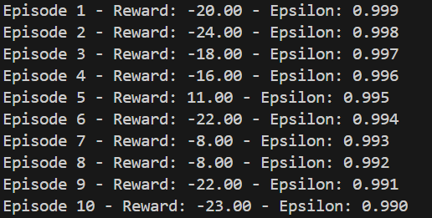
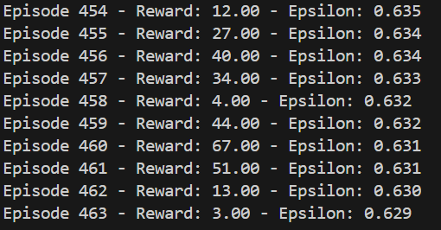
Training Process
train.py
This file is used to train the snake using Deep Q-Learning.
It runs the game for many episodes, collects experience, and updates the model to make better moves over time.
env.py
This file creates a special version of the game where the snake can interact using actions like UP, DOWN, LEFT, and RIGHT.
It returns rewards based on the snake's actions and helps the model learn.

Slide 9
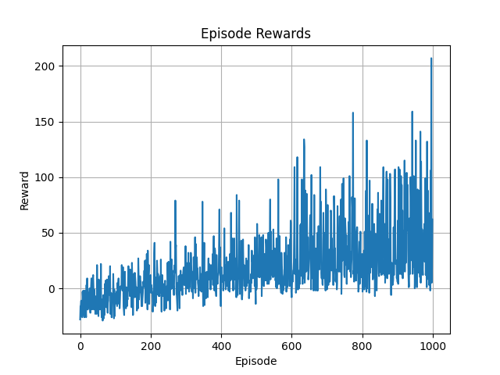
board_fast.py
This is a simplified, faster version of the snake game board used during training.
It doesn’t include visuals, so training runs quicker.
test_env.py and test_model.py
These are testing scripts that help check if the environment and model are working correctly before and after training.
dqn_snake_model.pth
This is the saved trained model file.
After training, the model is saved here so it can be reused without retraining.
training_rewards.png
A graph showing how the reward improves during training.
It helps us understand if the model is learning well over time.
Testing Process

Slide 10
Trained AI Agent
After training, the AI agent (snake) is able to play the game by itself without any help from a human.
The trained agent makes smarter decisions like:
Moving toward apples
Avoiding walls
Trying not to hit its own body (most of the time)
The agent improves over time and learns from thousands of past moves, stored during training.
In the testing phase (play_trained.py), the snake automatically survives longer and eats more apples compared to random or beginner behavior.

Slide 11
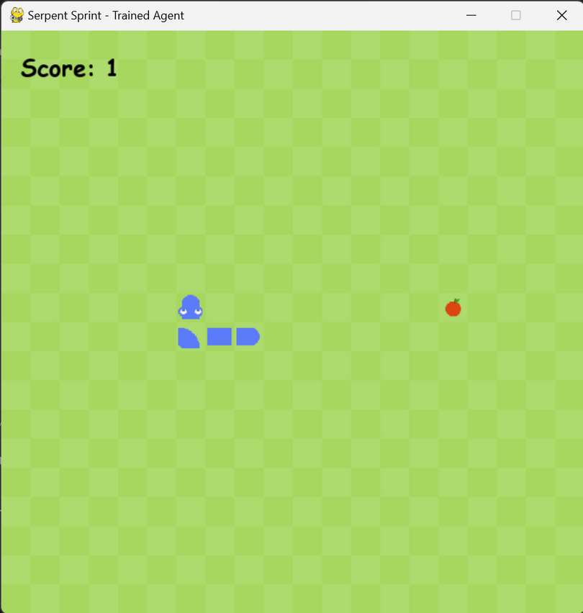
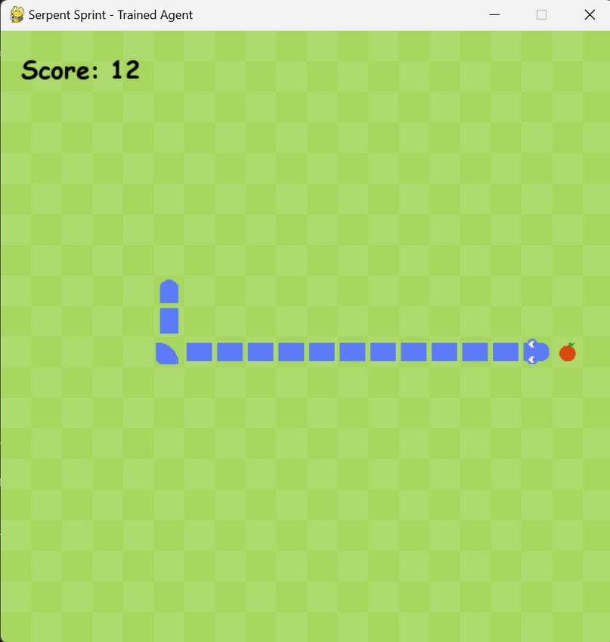

Slide 12
Conclusion
Our AI agent was trained using Deep Q-Learning (DQN), which helped it learn from experience without any human guidance.
Over many episodes, the model learned to make smart decisions like going toward apples and avoiding walls or its own body.
The use of a Replay Memory and a neural network allowed the agent to improve continuously by learning from past actions.
After training, the agent was able to play the Snake Game autonomously, showing stable and improved performance.
This project shows how reinforcement learning can be applied to real-time games, creating agents that adapt and learn over time.

Slide 13
Thank You!
https://github.com/KondepudiAbhishek/Dsci661201AI

